Slide 1


Introduction to Linux (Puppy Linux)
“Linux at the Command Line”
Notes:
Tux source: http://upload.wikimedia.org/wikipedia/commons/thumb/a/af/Tux.png/220px-Tux.png

Slide 2
UNIX Introduction
The UNIX operating system is made up of three parts;
the kernel, the shell and the programs.
The kernel of UNIX is the hub of the operating system:
it allocates time and memory to programs and handles the file store and communications in response to system calls.
The shell acts as an interface between the user and the kernel.

Slide 3
Unix
Developed at AT&T Bell Labs
Single monolithic kernel
Kernel mode
File system, device drivers, process management
User programs run in user mode
networking

Slide 4
What is Unix?
A multi-task and multi-user Operating System
Developed in 1969 at AT&T’s Bell Labs by
Ken Thompson (Unix)
Dennis Ritchie (C)
Douglas Mcllroy (Pipes - Do one thing, do it well)
Some other variants: System V, Solaris, SCO Unix, SunOS, 4.4BSD, FreeBSD, NetBSD, OpenBSD, BSDI
64% of the world’s servers run some variant of Unix or Linux. The Android phone and the Kindle run Linux.

Slide 5
What is Linux?
A clone of Unix
Developed in 1991 by Linus Torvalds, a Finnish graduate student (at the age of 21 !)
Inspired by and replacement of Minix
Linus' Minix became Linux
Consist of
Linux Kernel
GNU (GNU is Not Unix) Software
Software Package management
Others
http://www.linuxdevices.com/files/misc/ibm-watchpad.jpg

Slide 6

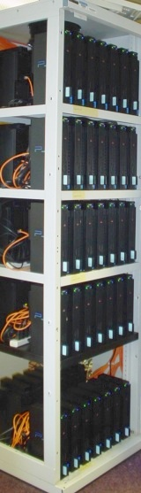
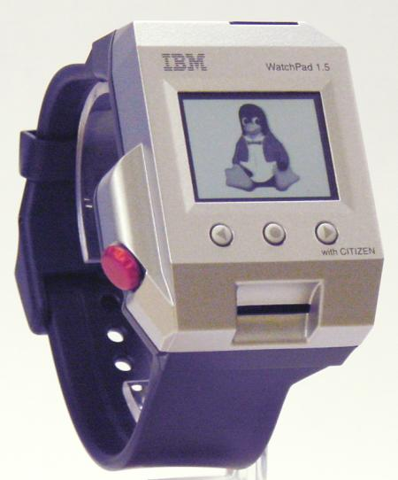

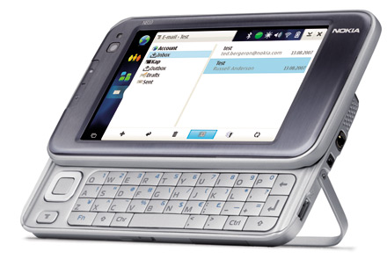




What is Linux?
Originally developed for 32-bit x86-based PC
Ported to other architectures, eg.
Alpha, VAX, PowerPC, IBM S/390, MIPS, IA-64
PS2, TiVo, cellphones, watches, Nokia N810, NDS, routers, NAS, GPS, …
* See references at the end
for the corresponding websites.

Slide 7
Which Linux Distribution is better?
> 300 Linux Distributions
Slackware (one of the oldest, simple and stable distro.)
Redhat
RHEL (commercially support)
Fedora (free)
CentOS (free RHEL, based in England)
SuSe ( based in German)
Gentoo (Source code based)
Debian (one of the few called GNU/Linux)
Ubuntu (based in South Africa)
Knoppix (first LiveCD distro.)
PuppyLinux

Slide 8

Linux Has Many Distributions
Notes:
Logos source: http://www.muylinux.com/wp-content/uploads/2009/04/logos-distros.jpg

Slide 9
Run-levels in Linux Distributions
A runlevel is a preset operating state on a Unix-like operating system. ... Seven runlevels are supported in the standard Linux kernel (i.e., core of the operating system).
0 – Halt.
1 – Single-user text mode
2 – Not used (user-definable)
3 – Full multi-user text mode.
4 – Not used (user-definable)
5 – Full multi-user graphical mode (with an X-based login screen)
6 – Reboot

Slide 10
Reference: Linux Fundamentals, Paul Cobbaut
Part III: Working in Command Line (root#)
– root prompt
Man pages
Directories
Files
Linux File System

Slide 11
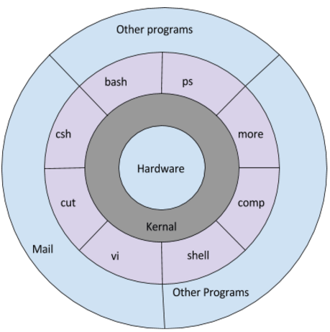
Unix Shell

Slide 12
Command Format
Format: command name and 0 or more arguments: % commandname [arg1] ... [argN]
By % (or “root#” or $) sign means prompt here and hereafter.
This is called as the Unix Shell
Arguments can be
options (switches to the command to indicate a mode of operation) ; usually prefixed with a hyphen (-) or two (--) in GNU style
non-options, or operands, basically the data to work with (actual data, or a file name)

Slide 13
Command I/O
Input to shell:
Command name and arguments typed by the user
Input to a command:
Keyboard, file, or other commands
Standard input: keyboard.
Standard output: screen.
These STDIN and STDOUT are often together referred to as a terminal.
Both standard input and standard output can be redirected from/to a file or other command.
File redirection:
< input
> output
>> output append

Slide 14
Create user – First command to learn
Open your Lab Observation Note books: Note that all commands are case sensitive and use only lower case letters:
Command prompt: root# adduser <name>
Example: adduser cs101 (creates a user named cs101 and
Prompts for password – enter password
To goto that user: type login: <enter the name>, prompts for password: <enter password> (Mypassword)
Now you are in a secure shell and user account and your work is safe and secure.
Type exit to logout of that user
WORK ONLY IN YOUR USER – ELSE FILES MAY BE CORRUPTED AND YOU MAY HAVE TO RE INSTALL LINUX.

Slide 15
Man pages – Manual Pages (Help)
Most Unix files and commands have pretty good man pages to explain their use.
Man pages also come in handy when you are using multiple flavours of Unix or several Linux distributions since options and parameters sometimes vary.
The first command to remember
Contains info about almost everything :-)
other commands
system calls
c/library functions
other utils, applications, configuration files
To read about man itself type: % man man
NOTE: unfortunately there’s no % man woman ...

Slide 16
The “man” command
Type these following commands in your “root#” prompt and record the answers (a short note of 3 lines) in your “root#” man <command>
man whoami
man hostname
man passwd

Slide 17
Help command
Command help
Examples
man –help
cal –help
date –help
help –help

Slide 18
date
Displays dates in various formats
% date
% date –u # in GMT
% date --date=" string “
date –date="2/02/2010“
date –date=“2 year ago”
date –date=“2 day ago”
date --date="next tue“
date –date=“2 day”
date –date=“1 year”
date –date=
$date "+%D"
Output: 10/11/17
Command: $date "+%D %T" Output: 10/11/17 16:13:27 Command: $date "+%Y-%m-%d"
Output: 2017-10-11
Command: $date "+%Y/%m/%d" Output: 2017/10/11
Command: $date "+%A %B %d %T %y"
Output: Thursday October 07:54:29 17

Slide 19
Editor in Puppy Linux
Text editor (Menu-document-Geany Text Editor)
Can be used to enter text/ programs
Click on editor (or type geany from prompt)
Type contents:
Hello World
I am “put your rollno and name”
I study First year B.Tech CSE
CS101 – Computer Systems Essentials
Save file as “myfile1”
Create 3 more files namely myfile2, myfile3, myfile4 with contents about each course of this semester (3 to 4 lines)
We will use this later

Slide 20
cal
Calendar
for month
entire year
Years range: 1 - 9999
No year 0
Calendar was corrected in 1752 - removed 11 days
% cal current month
% cal 2 2000 Feb 2000, leap year
% cal 2 2100 not a leap year
% cal 2 2400 leap year
% cal 9 1752 11 days skipped
% cal 0 error
% cal 2002 whole year

Slide 21
clear
Clears the screen
There’s an alias for it: Ctrl+L
Example sequence:
% cal
% clear
% cal
Ctrl+L

Slide 22
sleep
“Sleeping” is doing nothing for some time.
Usually used for delays in shell scripts.
% sleep 2
2 seconds pause (you can also sleep for 2 seconds !!)

Slide 23
Command Grouping
Semicolon: “;”
Often grouping acts as if it were a single command, so an output of different commands can be redirected to a file:
% (date; cal; date) > out.txt

Slide 24
history
Display a history of recently used commands
% history
all commands in the history
% history 10
last 10
% history -r 10
reverse order
% !!
repeat last command
% !n
repeat command n in the history
% !-1
repeat last command = !!
% !-2
repeat second last command
% !ca
repeat last command that begins with ‘ca’

Slide 25
System Information Commands
date | display the current date and time
cal | display a monthly calendar
uptime | display current uptime
uname -a | display kernel information
uname -r | display kernel version
cat /proc/cpuinfo | display cpu information
dmesg | display kernel (and driver) messages
free | display memory and swap usage
df | display disk usage
du -h /PATH/DIR | display summarized disk usage for /PATH/DIR
env | displays the actual environment

Slide 26
File Commands
ls | directory listing
ls -al | formatted listing with hidden files and long listing
cd DIR | change directory to childdir DIR
cd /PATH/DIR | change directory to /PATH/DIR
cd .. | one dir up
cd - | change to last directory
cd | change to home
pwd | display current directory

Slide 27
Directory Commands
mkdir DIR | create a directory in the actual path
mkdir /PATH/DIR | create a directory in PATH
mkdir -p /PATH/DIR | create a directory in PATH even if not all dirs in PATH exist
rm FILE* | delete FILE
rm -r DIR* | delete all files in the directory and the directory named DIR

Slide 28
Absolute and relative paths
A path is a unique location to a file or a folder in a file system of an OS.
A path to a file is a combination of / and alpha-numeric characters.
Absolute Path-name: An absolute path is defined as the specifying the location of a file or directory from the root directory(/). To write an absolute path-name:
Start at the root directory ( / ) and work down.
Write a slash ( / ) after every directory name (last one is optional)
Example: cat passwd – shows no such file or directory
Type: cd /etc , pwd, cat passwd --- shows the password file
Or cat /etc/passwd (absolute path of the file to be given)
Type cat /etc/protocols, cat /etc/pkg/pkgrc -- Absolute path
The tab key can help you in typing a path without errors. Typing cd /et followed by the tab key will expand the command line to cd /etc/.

Slide 29
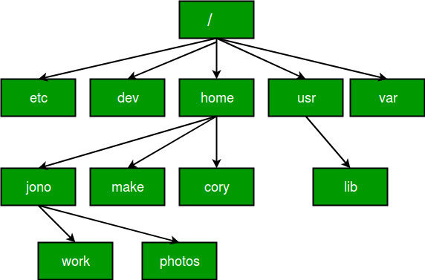
Relative path
Relative path is defined as the path related to the present working directly(pwd).
It starts at your current directory and never starts with a /
Sample directory structure

Slide 30
Relative Path
UNIX offers a shortcut in the relative pathname– that uses either the current or parent directory as reference and specifies the path relative to it.
A relative path-name uses one of these cryptic symbols:
.(a single dot) - this represents the current directory.
..(two dots) - this represents the parent directory.
if we are currently in directory “/home/kt/abc” and now you can use “..” as an argument to “cd” to move to the parent directory /home/kt as : pwd (shows current working directory),
cd .. (moves one level up)

Slide 31
Example – Do the following:
Find your working directory (pwd)
Create the following tree
Type mkdir vehicle, cd vehicle, pwd, mkdir car, cd car, mkdir benz….
Type the following Commands:
pwd, goto Vehicle, pwd, goto Car, pwd, goto Benz, pwd
How to goto Audi?
How to goto Car?
How to goto Sleeper?
How to goto Special?
How to return to your home?
Write both absolute and relative path
Vehicle
Car
Audi
Bus
Volvo
Ashok
Special
Sleeper
Benz

Slide 32
File Commands
cp FILE1 FILE2 | copy FILE1 to FILE2
mv FILE1 FILE2 | rename or move FILE1 to FILE2 if FILE2 is an existing directory, moves FILE1 into directory FILE2
touch FILE | create FILE
command > FILE | (re-)places output of command in FILE
command >> FILE | appends output of command to FILE
command < FILE | use FILE as input for command
cat FILE | display the content of FILE
tac FILE | display the content of FILE from last to first line
head FILE or head –n FILE | display the first 10 lines of FILE or n lines from FILE
tail FILE | display the last 10 lines of FILE
tail -f FILE | display the content of FILE as it grows, starting with the last 10 lines
file FILE | gives info about FILE -- nature of file

Slide 33
To learn more commands -- Create files
Create myfile with the following contents:
echo “I am fine, I do CSE” > myfile
echo “I am good, I like CSE” >> myfile
echo “I like drawing” >>myfile
echo “I like reading” >>myfile
echo “I like writing” >> myfile
Show the contents of myfile: cat myfile

Slide 34
To learn more commands
cat and tac -- concatenate (display) – tac (last line to first line)
Ex: cat myfile – display file contents, tac myfile – display last to first
grep is to filter lines of text containing (or not containing) a certain string.
Ex: grep “CSE” myfile – displays all lines that contain CSE from myfile
Ex: grep “like” myfile – displays all lines that contain “like” from myfile
Word Count – wc options <filename>
Gives the no. of lines, words and characters in the file
Ex: wc myfile
Ex: wc –l myfile -- no. of lines only
Ex: wc –w myfile – no. of word
Ex: wc –c myfile – no. of characters

Slide 35
Some more ….
Sorting: sort filter will default to an alphabetical sort.
Ex: sort myfile – sorts based on the alphabetical order
Ex: cat /etc/passwd
Ex: sort /etc/passwd
Unique lines -- uniq you can remove duplicates from a sorted list.
Ex: uniq myfile – displays only unique lines
Difference – diff command used to display the differences in the files by comparing the files line by line. it tells us which lines in one file have is to be changed to make the two files identical. (a – add, c – change, d – delete)
Ex: head -2 myfile > myfile1 (first two lines of myfile goes to myfile1)
diff myfile myfile1 -- shows difference between myfile and myfile1 in terms of where to add, change and delete

Slide 36
Practice the following:
tac myfile > myfile1
echo “periodical test 1” >> myfile1
echo “cs101 – csessentials” >> myfile1
ls –l
ls –lh
wc myfile
sort myfile
grep “cse” myfile
uniq myfile myfile1
diff myfile myfile1
head -3 myfile
tail -4 myfile1
head -5 myfile >myfile2
tail -3 myfile >myfile3
mkdir d1
mkdir d2
mkdir d3
cd d1
pwd
cal (all options)
date (all options)
cd (all options, absolute and relative path)
sleep 2
sort myfile
cal:date:echo :myname” > f1
cp f1 f2
cp f2 f3
rm f3
mv f1 f3

Slide 37
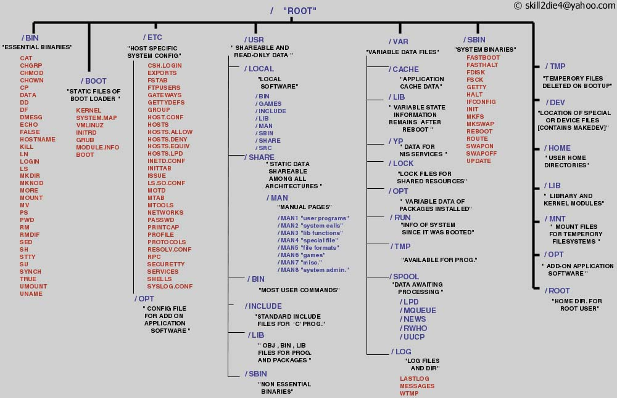
The Linux File System
Notes:
Source: http://www.tuxmachines.org/images/linux_file_structure.jpg

Slide 38
Permissions in Linux
Permission Groups
Each file and directory has three user based permission groups:
owner - The Owner permissions apply only the owner of the file or directory, they will not impact the actions of other users.
group - The Group permissions apply only to the group that has been assigned to the file or directory, they will not effect the actions of other users.
all users - The All Users permissions apply to all other users on the system, this is the permission group that you want to watch the most.
Permission Types
Each file or directory has three basic permission types:
read - The Read permission refers to a user's capability to read the contents of the file.
write - The Write permissions refer to a user's capability to write or modify a file or directory.
execute - The Execute permission affects a user's capability to execute a file or view the contents of a directory.

Slide 39
Viewing the Permissions
You can view the permissions by the output of the "ls -l" command
displayed as: _rwxrwxrwx 1 owner:group
User rights/Permissions
The first character that I marked with an underscore is the special permission flag that can vary. (d- directory, l-linked file…)
The following set of three characters (rwx) is for the owner permissions.
The second set of three characters (rwx) is for the Group permissions.
The third set of three characters (rwx) is for the All Users permissions.
Following that grouping since the integer/number displays the number of hard links to the file.
The last piece is the Owner and Group assignment formatted as Owner:Group.

Slide 40
Modifying the Permissions of a file: chmod
The Permission Groups used are:
u - Owner
g - Group
o - Others
a - All users
The potential Assignment Operators are + (plus) and - (minus); these are used to tell the system whether to add or remove the specific permissions.
The Permission Types that are used are:
r - Read
w - Write
x - Execute

Slide 41
Examples:
Create a file named as: file1
Type ls -l, you get this:
_rw_rw_r_ _ which means that the owner, group and all users have only read permission.
Now we want to remove the read and write permissions from the all users group.
To make this modification you invoke the command: chmod a-r file1
To add the permissions above you would invoke the command: chmod a+rw file1
As you can see, if you want to grant those permissions you would change the minus character to a plus to add those permissions.

Slide 42
Using Binary References to Set permissions
The numbers are a binary representation of the rwx string.
r = 4
w = 2
x = 1
Example: chmod 640 file1, which means that the owner has read and write permissions (4+2), the group has read permissions (4), and all other user have no rights (0) to the file.
What is chmod 777 file1?
What is chmod 600 file1?
What is chmod 000 file1?

Slide 43
Owners and Groups
Change owner and Groups: -- can be done only by super user/ root/ admin
chown “username” filename(s)
chgrp “groupname” filename(s)

Slide 44
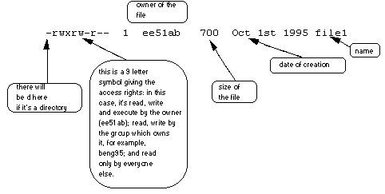
File system security (access rights)
-rwxrwxrwx | a file that everyone can read, write and execute (and delete).
-rw------- | a file that only the owner can read and write - no-one else can read or write and no-one has execution rights (e.g. your mailbox file).

Slide 45
Unix File Permissions
File type, owner, group, others
drwx------ 2 jjoshi isfac 512 Aug 20 2003 risk management
lrwxrwxrwx 1 jjoshi isfac 15 Apr 7 09:11 risk_m->risk management
-rw-r--r-- 1 jjoshi isfac 1754 Mar 8 18:11 words05.ps
-r-sr-xr-x 1 root bin 9176 Apr 6 2002 /usr/bin/rs
-r-sr-sr-x 1 root sys 2196 Apr 6 2002 /usr/bin/passwd
File type: regular -, directory d, symlink l, device b/c, socket s, fifo f/p
Permission: r, w, x, s or S (set.id), t (sticky)
While accessing files
Process EUID compared against the file UID
GIDs are compared; then Others are tested

Slide 46
Exercise
Work with Chapter 8.8
Write your results in Lab Observation Notebook
Verify your results with Chapter 8.9

Slide 47
More commands in prompt
type -- To find out whether a command given to the shell will be executed as an external command or as a builtin command
Ex: type cd -- cd is a shell built-in
Internal command (available in OS)
type cat -- cat is /bin/cat
External command (added to OS)
which Ex: which ls – shows the directory where ls is stored

Slide 48
Environment variables / Shell variables
Denoted with $sign and all words in UPPERCASE only
$HOSTNAME, $USER, $UID, $SHELL, and $HOME
Try the following and write the answers in your lab note book:
echo This is the $SHELL shell -- This is the /bin/bash shell
echo This is $SHELL on computer $HOSTNAME
echo The userid of $USER is $UID
echo My homedir is $HOME
echo My path is $PATH

Slide 49
Pipes in Unix
Denoted with “|” symbol – shift +\ symbol is pipe – Input to next command is output of previous command
Examples: Do the following and record in your note book
Type ls | grep “my” - write the output
Create a file with the following lines:
Create myfile with the following contents:
echo “I am fine, I do CSE” > myfile
echo “I am good, I like CSE” >> myfile
echo “I like drawing” >>myfile
echo “I like reading” >>myfile
echo “I like writing” >> myfile
Show the contents of myfile: cat myfile
Type: cat myfile | grep “like” – write the output
Type cat myfile | grep -v “like” -- what happened?

Slide 50
More on pipes
cat /etc/passwd – what do you see
Lets learn “cut” command
Type cat /etc/passwd | cut –d “:” -f1,3 -- what do you get
You get the fields 1 and 3 from /etc/passwd and the file is delimited (separated) using “:”
Create mymarks with the following contents:
echo “101:CSE:25> mymarks; echo “100:PSAT:35”” >> mymarks
echo “102:ENG:33”” >> mymarks; echo “203:MAT:42”” >> mymarks
echo “204:CUL:39”” >> mymarks; Show the contents of mymarks
cut –d”:” -f1,2 mymarks – what do you get
cat mymarks | cut –d”:” –f1,2 – what do you get
cat mymarks | grep “100” | cut –d”:” –f1,2 – what do you get
cat mymarks | grep “2*” | cut –d”:” –f1,2 – what do you get
cut -c2-7 /etc/passwd | tail -4 -- what did you get

Slide 51
Some more on pipes
Command: tr -- tr “from” “to” – translates one string to another
ls | tr 'e' 'E‘ -- shows the translation of all occurrences of e to E.
cat /etc/passwd |tr “m” “ME” – see what happens
cat /etc/passwd |tr “a-z” “A-Z” – see what happens
cat /etc/passwd |tr “abcde” “pqrst” – see what happens (Encryption)
Command wc – count lines, words, chars
cat /etc/passwd | wc – what is the output
cat /etc/passwd | wc -l – what is the output
cat /etc/passwd | wc -c– what is the output

Slide 52
More pipes
The sort filter will default to an alphabetical sort.
cat mymarks | sort -k7 -- sorts based on 7th character in file
cat mymarks | grep “10?” | sort –k5 – what is the output
ps | wc
ps | sort

